Slide 1
Content Management
Systems
An Overview

Slide 2
Introit
Define “CMS”
Two Branches:
  Full Content Management
  Web Applications

Slide 3

Second System Effect
Fred Brooks, 1975
OS/360
Unix vs. MULTICS
Windows “Cairo”
SharePoint

Slide 4
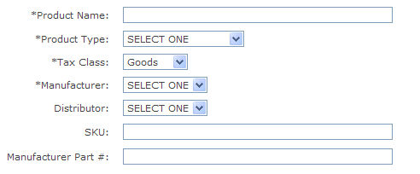
Data

Slide 5
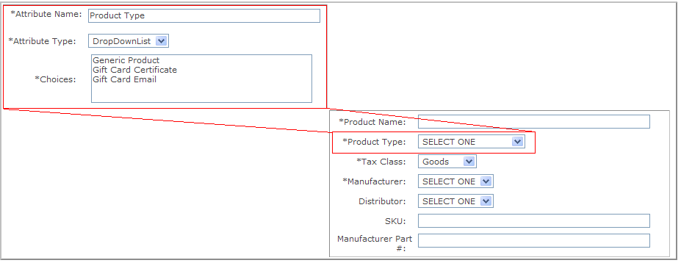
Data, Metadata

Slide 6
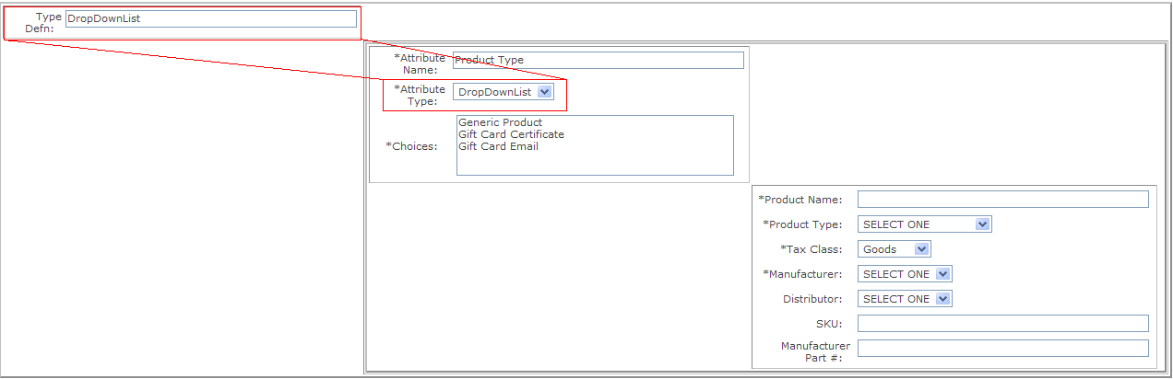
Data, Metadata, Meta-Metadata

Slide 7
SharePoint Overview
…as an internal portal
…as a public web site
“Simple” Content Management

Slide 8
SharePoint Technology Stack
IIS
SQL Server
.NET 2.0 / WebParts
Active Directory
Office 2007

Slide 9
SharePoint
PRO
  Microsoft Support
  Many Features
  Integration
  3rd Party Components
  Microsoft Solution
CON
  $$$$$
  Licenses
  Difficult to set up
  Difficult to maintain
  Performance?
  Microsoft Solution

Slide 10
SharePoint Conclusions
Not advised for…
  …“simple” CMS (overkill)
  …low integration needs
Excellent for…
  … an information portal
  … host environment for other web apps
  … complicated workflow
  BIG systems

Slide 11
Dot Net Nuke Overview
Content Management System
Evolution
  Jan 2002 - IBuySpy Starter Kit
  Dec 2002 – IBuySpyWorkshop
  2003 – renamed DotNetNuke
  2007 – Upgraded to .NET 2.0

Slide 12
Dot Net Nuke Technology Stack
IIS
SQL Server
VB.NET / “Modules”
Version 3 = .NET 1.1
Version 4 = .NET 2.0

Slide 13
Dot Net Nuke
PRO
  Free
  Open Source
  Large Community
  3rd Party Components
  Easy to Admin
CON
  Structure / Design
  2nd System Effect
  No Workflow
  No Integration
  Immature Community
  Poor Quality Core
  Poor Quality Components

Slide 14
Dot Net Nuke Conclusions
Not advised for…
  … complex Portals or Web Apps
  … sites requiring workflow management
  … complex visual requirements
Excellent for…
  … simple web sites
  … simple content management

Slide 15
ASPDotNetStoreFront
eCommerce / Shopping Cart Platform
.NET 2.0
Not strictly “Content Management”
Highly Configurable

Slide 16
Storefront Technology Stack
IIS
SQL Server (and others)
.NET 2.0

Slide 17
ASP.NET StoreFront
PRO
  Lots of Features
  Very Configurable
  eCommerce built in
  Source Code Available
CON
  Management can be overwhelming
  Difficult to extend
  Poor Code Quality
    Not very .NET-like

Slide 18
ASP.NET Storefront Conclusions
Good starting point for simple product sales sites
Difficult to extend
Possibly difficult to maintain
Not a general purpose CMS

Slide 19
Drupal
https://blog.blackfintech.com
Very Configurable
Technology: LAMP
  Linux / Apache / MySql / PHP

Slide 20
Drupal
PRO
  Free
  Community Support
  Extensible by Design
  Skins
  Linux
CON
  Documentation
  FOSS Community
  Scalable?
  Linux

Slide 21
Drupal Conclusions
Excellent for non-Microsoft environments
Good general purpose CMS

Slide 22
Final Thoughts
Questions

